Slide 1
Requirement Engineering – A Roadmap
Eliciting Requirements
Modeling and Analysis Requirements
Communicating Requirements
Agreeing Requirements
Evolving Requirements
Integrated Requirements Engineering

Slide 2
Requirements Engineering
Requirements
Definition
Feasibility
Study
Requirements
Gathering and
Analysis
Feasibility
Report
Requirements
Specification
System
Models
V&V
SRS
Requirements
Definition
Document (RDD)
*Software Project
Management
Plan
User Manual
Test Plan
Notes:
∇ ∇

Slide 3
Gathering Requirements
How to gather requirements
  Boundaries
    Identify the high level boundaries of the system
    Stakeholders and Use Cases depend on boundaries
  Stakeholders
    Customer or Clients
    Developers
    Users
  Goals
    Extract High level goals early in development
  Tasks
    When it is difficult to articulate user requirements

Slide 4
Eliciting Requirements (contd.)
Elicitation Techniques
  Traditional Techniques
    Questionnaires and Surveys
    Interviews
    Analysis of existing documentation
  Group Elicitation
    Group brainstorming sessions
    RAD (Rapid Application Development)
    JAD (Joint Application Design)
  Prototyping
    Where there is great deal of uncertainty
    Early feedback from stakeholders is needed

Slide 5
Modeling and Analysis Requirements
  “ The construction of abstract descriptions that are amenable to interpretation ”
Enterprise Modeling
  Understanding organization's structure
  Business rules
  Goals, tasks and responsibilities
  Data
Data Modeling
  Understand, manipulate and manage large volume of information
  How to represent real world phenomenon into system information

Slide 6
Modeling and Analysis Requirements (contd.)
Behavioral Modeling
  Dynamic or Functional behavior of stakeholders and system, both existing and required
Domain Modeling
  Abstract description of the world in which the system will operate
  Requirements reuse within a domain
Modeling Non-Functional Requirements
  Difficult to express in a measurable way
  Difficult to analyze
  Properties of a system as a whole

Slide 7
Modeling and Analysis Requirements (contd.)
Analyzing Requirements Models
  Requirements Animation
  Automated Reasoning
  Analogical and Case-based Reasoning
  Knowledge based
  Consistency Checking

Slide 8
Communicating Requirements
Requirement Management
  “ The ability, not only to write requirements but also to do so in a form that is readable and traceable by many, in order to manage their evolution over time ”
Requirement Traceability (RT)
  “ The ability to describe and follow life of a requirement in both forwards and backwards direction ”

Slide 9
Agreeing Requirements
Maintaining agreement with the stakeholders can be a problem
Validation
  “ Validation is the process of establishing that the requirements and models elicited provide an accurate account of stakeholder requirements ”
Validation is difficult for two reasons:
  Question of truth and what is knowable
  Reaching agreement among different stakeholders

Slide 10
Evolving Requirements
Adding requirements
  Changing stakeholder needs
  Missed in initial analysis
Requirement Scrubbing – Removing requirements
  Usually only during development, to forestall cost and schedule overruns
Manage inconsistency in requirements
Managing changing requirements
  Continued requirement elicitation
  Evaluation of Risk
  Evaluation of systems in the environment

Slide 11
Evolving Requirements (contd.)
Product Family
  Increasingly important form of development activity
  Range of software product that share similar requirements and architectural characteristics, yet differ in certain key requirements
  Research issue : Identifying the core requirements for the architectures that are:
    Stable in the presence of change
    Flexible enough to be customized and adapted to changing requirements

Slide 12
Integrated Requirements Engineering
Different approaches to manage and integrate RE activities:
  Problem Frames
  Viewpoints
Automated tools:
  DOORS
  Requisite Pro
  Cradle

Slide 13
Prioritizing requirements (MoSCoW)
Must haves: top priority requirements
Should haves: highly desirable
Could haves: if time allows
Won’t haves: not today

Slide 14
Different techniques for requirements elicitation and analysis
Different techniques for elicitation:
  Brainstorming
  Stories
  Prototyping
  Questionnaires
  Interviewing
  Viewpoint
  Scenarios
  Use cases

Slide 15
A GOOD REQUIREMENT PAPER

Slide 16
Requirements analysis
Read the paper ‘The Art of Requirements Triage’, Alan Davis, IEEE computer, March 2003
MoSCoW Criteria for requirements triage:
  M – Must have – mandatory requirements that are fundamental to the system
  S – Should have – important requirements that could be omitted
  C – Could have – optional requirements
  W – Want to have – the requirements really can wait

Slide 17
WHAT ARE VIEWPOINTS

Slide 18
Viewpoints
Viewpoints permits us to classify stakeholders and other sources of requirements
  Multi-perspective analysis / diversity of source of information are important
3 categories of viewpoints
  Interactor viewpoints: People or other systems that interact with the system
  Indirect viewpoints: Stakeholders who do not use the system directly but who influence the requirements in some ways
  Domain viewpoints: Domain characteristics and constraints

Slide 19
Viewpoints
More specific viewpoints:
  Providers and receivers of system services
  Systems interfacing with the new system
  Regulations and standards applying to the system
  Sources of business and non-functional requirements
  Engineering viewpoints: developing, managing, maintaining the system
  Marketing viewpoints

Slide 20
THE VORD METHOD

Slide 21
The VORD method
This method implements a viewpoint-oriented approach for requirements elicitation
VORD = Viewpoint Oriented Requirements Definition
It is based on:
  Viewpoint identification
    Discovering the viewpoints, services and constraints
  Viewpoint structuring
    Allocating services to viewpoints
    Viewpoint data/control
    Group the viewpoints into a hierarchy
  Viewpoint documentation
    Refine the description of the viewpoints, services and constraints
    Use of a template
  Viewpoint system mapping
    Transform the analysis to an object-oriented design

Slide 22
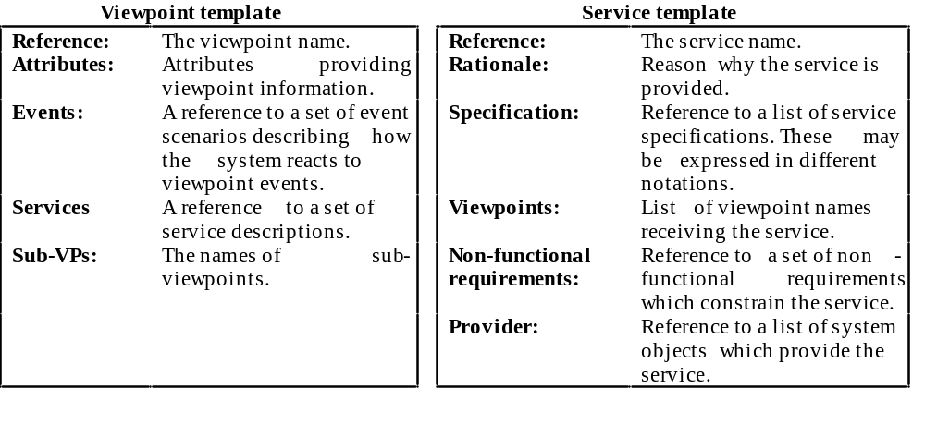
VORD template

Slide 23
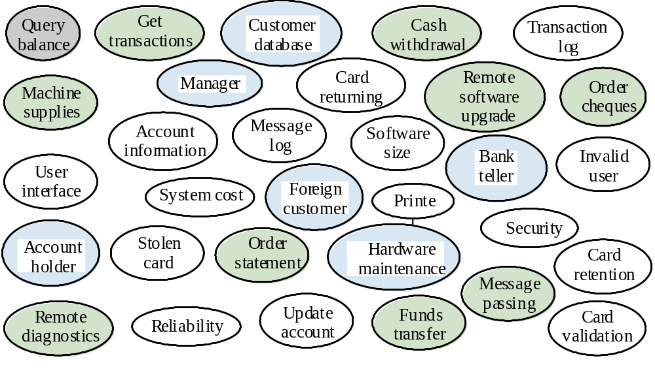
Example: ATM
Viewpoint identification

Slide 24
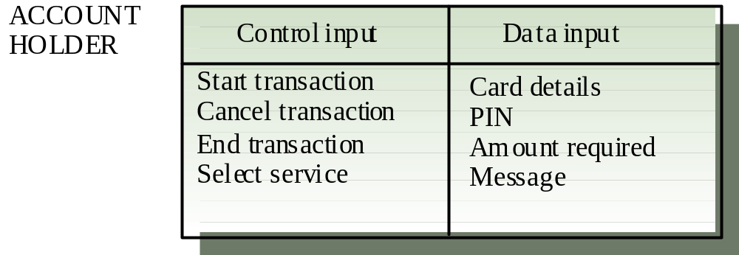
Example: ATM
Viewpoint structuring: Viewpoint data/control

Slide 25
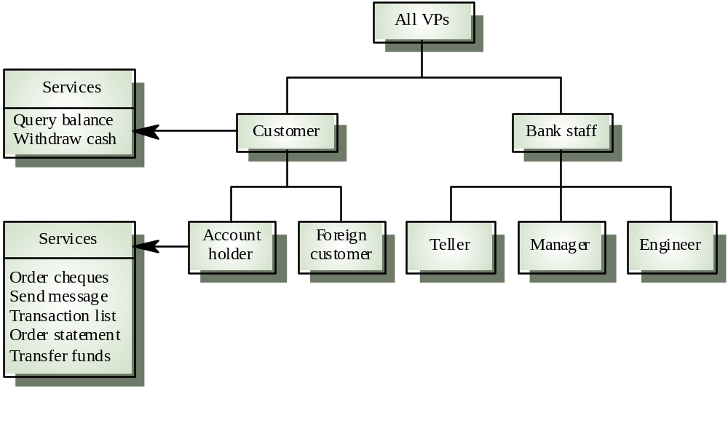
Example: ATM
Viewpoint structuring: Viewpoint hierarchy

Slide 26
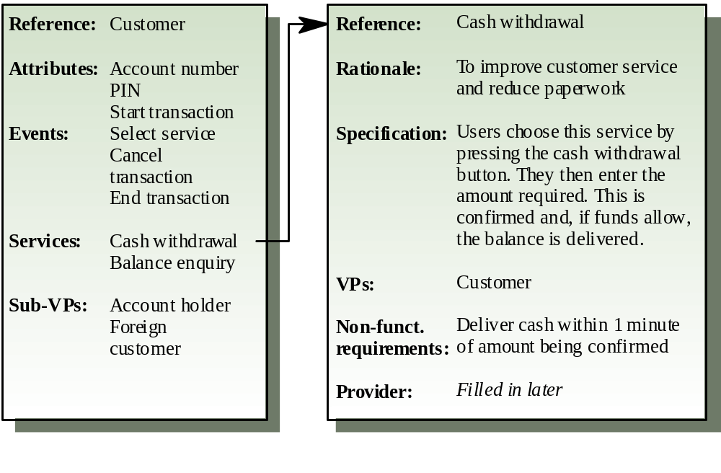
Example: ATM
Viewpoint documentation

Slide 27
WHAT ARE SCENARIOS

Slide 28
Scenarios
If it often easier for people to relate on real-life example rather than abstract statements
Scenarios are descriptions – sequences of events - of how the system is used in practice.
Scenarios are composed of:
  A description of the initial state of the system
  A description of the normal flow of events in the scenario
  A description of what can go wrong and how it is handled
  Information on other activities that might be going on concurrency
  A description of the final state of the system

Slide 29
REQUIREMENTS VALIDATION

Slide 30
Requirements validation
Requirements must be checked for:
  Validity, comprehensibility, traceability (source, dependency between requirements) consistency, completeness, realism and verifiability
Validation techniques:
  Requirements reviews
    Expert review, two independent reviews
    Formal/informal
    Involvement of the stakeholders necessary
  Test-case generation
    Tests are developed for the requirements
  Prototyping
  Mini-definitions of the requirements
    A team redefine the requirements and compare them with the list of produced requirements

Slide 31
PROPERTIES OF GOOD REQUIREMENT

Slide 32
Properties of good requirement
Unitary.
Complete.
Consistent.
Current.
Feasible.
Unambiguous.
Traceable.

Slide 33
WHAT IS TRACEABILITY

Slide 34
Traceability
Traceability as a general term is the “ability to chronologically interrelate the uniquely identiﬁable entities in a way that matters.“
The IEEE Standard Glossary of Software Engineering Terminology deﬁne traceability as ”the degree to which a relationship can be established between two or more products of the development process, especially products having a predecessor-successor or master-subordinate relationship to one another.“

Slide 35
Traceability
The ability to describe and follow the life of a requirement, in both forward and backward directions.
The ability to deﬁne, capture and follow the traces left by requirements on other elements of the software development process and the traces left by those elements on requirements.

Slide 36
Traceability
An intensive iterative process which involves labeling each requirement in a unique and persistent manner so they can be unambiguously referred to throughout the development cycle.

Slide 37
Requirements traceability facilitates the following:
Understanding the software under development and its artifacts.
Ability to manage changes effectively.
Maintaining consistency between the product and the environment in which the product is operating.

Slide 38
Traceability links
Traceability links are used to track the relationship between each unique requirement and its source.
Traceability links are also used to track the relationship between each unique requirement and the work components to which that requirement is allocated.

Slide 39
Types of traceability
Good traceability practices allow for bi-directional traceability.
There are four types of traceability links that constitute bi-directional traceability.
Forward to requirements.
Backward from requirements.
Forward from requirements.
Backward to requirements

Slide 40
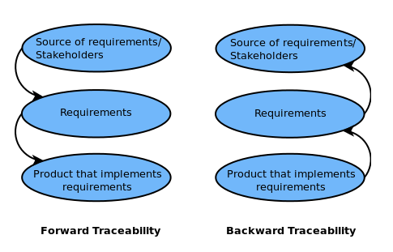
Bi-directional traceability links

Slide 41
Beneﬁts of traceability links
Traceability links help to keep track of interconnections and dependencies among requirements.
Monitoring the propagation of change that results when a speciﬁc requirement is deleted or modiﬁed.

Slide 42
Change Management Process

Slide 43
Why Do Requirements Change?
A requirements management process can be useful only if it recognizes and addresses the issue of change.
There are several reasons for the inevitability of changes to the requirements.
  Some of these reasons are internal factors and may be under our control
  But many of them are external factors and are outside the control of the developers and the users

Slide 44
External Factors
External factors are those change agents over which the project team has little or no control.
Changes occur because of :
  a change to the problem we attempting to solve
  the identity of the users changed
  The users changed their minds or their perceptions about what they wanted the system to do
  The external environment has changed, which creates new constraints and/or new opportunities.
  The existence of a new system causes the requirements for the system itself to change.
We can't prevent change, but we can manage it.

Slide 45
Internal Factors
We failed to ask the right people the right questions at the right time during the initial requirements gathering effort.
We failed to create a practical process to help manage changes to the requirements that would normally have happened on an incremental basis.
Iterating from requirements to design causes new requirements.

Slide 46
Unofficial Requirement Change
Some requirement changes are "official" external changes, representing customer requests made through the appropriate channels of communications
But many are "unofficial" (also known as "requirements leakage”). Examples:
  Direct customer requests to programmers
  Functionality inserted by programmers with "careful consideration" of what's good for the customer
Up to half of the total work product of the system are invested in requirements leakage!

Slide 47
A Process for Managing Change
Recognize that change is inevitable, and plan for it.
Baseline the requirements.
Establish a single channel to control change.
Use a change control system to capture changes.
Manage change hierarchically.

Slide 48
Step 1: Recognize That Change Is Inevitable, and Plan for It
The team must recognize that changing requirements for the system is inevitable and even necessary.
Develop a plan for managing change that should include some allowance for change in the initial baseline.

Slide 49
Step 2: Baseline the Requirements
In each iteration, the team should baseline the requirements for the build
  Putting version control on vision document, software requirements and use-case models
  Publishing it for the development team
Once the baseline has been established, new requirements can be more easily identified and managed.
  A request for a new requirement can be compared against the existing baseline to see where it will fit in and whether it will create a conflict with any other requirements.

Slide 50
Step 2: Baseline the Requirements
If the change is accepted, we can manage the evolution of that change from the vision to the software requirements, from the software requirements to the appropriate technical design documents and models, and then to the code and the test procedures.

Slide 51
Step 3: Establish a Single Channel to Control Change
Ad hoc changes to a software system can cause significant and unintended consequences
Every change should go through a single channel to determine its impact on the system and to make the official decision as to whether the change is going to be made in the system or not.
  For small projects, the official channel can be one person – e.g., the project manager
  For larger systems, the channel should consist of a few people who share the responsibility and make the decision together: Change Control Board (CCB)

Slide 52
Step 4: Use a Change Control System to Capture Changes
The team should implement a system for capturing all change requests.
When considering whether to approve a change request, the CCB must consider the following factors:
  The impact of the change on the cost and functionality of the system
  The impact of the change on customers and other external stakeholders not well represented on the CCB: other project contractors, component suppliers, and so on
  The potential for the change to destabilize the system

Slide 53
Step 4: Use a Change Control System to Capture Changes
Once a change has been approved, the next step is to decide where to insert the change.
  For example, we need to determine whether to change a requirement or to change a test being proposed.
  Subsequent changes will ripple through in the hierarchy

Slide 54
Step 5: Manage Change Hierarchically
A change to one requirement can have a ripple effect in other related requirements, the design, or other subsystems
  This fact may not be obvious to the requester, who casually asks the programmer to make a "quick and easy" change to the system.
If the requirements is well structured and the system is well encapsulated, changes should be limited to certain areas instead of being spread everywhere.
A programmer doesn't have the authority to introduce new features and requirements directly into the code on the user's behalf.

Slide 55
Requirements Configuration Management
Some elements of the preceding change review and approval process are referred to as change control, version control, or configuration management in some organizations.

Slide 56
Requirements Configuration Management
The benefits of requirements configuration management are:
  Prevents unauthorized and potentially destructive changes to the requirements
  Preserves the revisions to requirements documents
  Facilitates the retrieval and/or reconstruction of previous versions of documents
  Supports a managed, organized baseline "release strategy" for incremental improvements or updates to a system
  Prevents simultaneous update of documents or conflicting and uncoordinated updates to different documents at the same time.

Slide 57
Key Points
A process to manage requirements can be useful only if it recognizes and addresses the issue of change.
Internal change factors include failing to ask the right people the right questions at the right time and failing to create a practical process to help manage changes to requirements.
In order to have a reasonable probability of success, requirements leakage must be stopped or at least reduced to a manageable level.

